Slide 1
CFD Refinement
By: Brian Cowley

Slide 2
Overview
Background on CFD
How it works
CFD research group on campus for which problem exists
    Our current techniques
The problem I address
Possible solutions – testing different solution schemes
Test results
Possible concerns
Implications of results
Further research

Slide 3
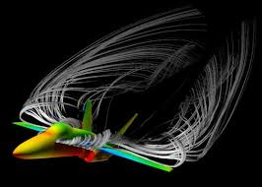
Background: What is CFD?
A branch of fluid mechanics that emphasizes the use of computers
Is able to create simulations of almost every aspect of fluid movement
Used in development of many modern technologies

Slide 4

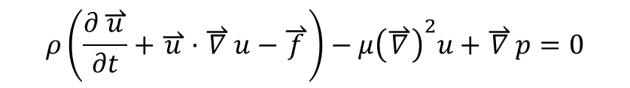
How it works – the problem
Relies entirely on computers for calculations. Why?
  Calculations are based on the Navier-Stokes equations
    There is no solution that exists to these equations
      The terms within the equation are partial differentials
So what do we do, since computers cannot do calculus?
$$ρ⁢\left(\frac{∂\overset{⇀}{u}}{∂t}+\overset{⇀}{u}·\overset{⇀}{∇}u−\overset{⇀}{f}\right)−μ⁢{\left(\overset{⇀}{∇}\right)}^{2}⁢u+\overset{⇀}{∇}p=0$$
$$\overset{⇀}{∇}·\overset{⇀}{u}=0$$

Slide 5
How it works – the solution
We use discrete math instead of continuous math
The discretized Navier-Stokes equation
  Replacing differentials with finite differences
  Computer algorithms can therefore be used
    Make some initial guess (initialize) the flow field
    Iterate until the initial guess converges to true
    solution
      Can be on the order of millions of iterations
$$\frac{{ω_{i,j}}^{n+1}−{ω_{i,j}}^{n}}{Δt}+\frac{1}{{s_{i,j}}^{2}}\left[\frac{\left(s_{i+1},j\right)⁢{\left(V_{i+1,j}\right)}^{n}⁢{\left(ω_{i+1,j}\right)}^{n}−\left(s_{i−1,j}\right)⁢{\left(V_{i−1,j}\right)}^{n}⁢{\left(ω_{i−1,j}\right)}^{n}}{2⁢Δμ}+\frac{\left(s_{i,j+1}\right)⁢{\left(V_{i,j+1}\right)}^{n}⁢{\left(ω_{i,j+1}\right)}^{n}−\left(s_{i,j−1}\right)⁢{\left(V_{i,j−1}\right)}^{n}⁢{\left(ω_{i,j−1}\right)}^{n}}{2⁢Δη}\right]=\frac{1}{{Re}_{M}⁢{\left(S_{i,j}\right)}^{n}}\left[\frac{{\left(ω_{i−1},j\right)}^{n}−2⁢{\left(ω_{i,j}\right)}^{n}+{\left(ω_{i+1,j}\right)}^{n}}{{\left(Δµ\right)}^{2}}+\frac{{\left(ω_{i},j−1\right)}^{n}−2⁢{\left(ω_{i,j}\right)}^{n}+{\left(ω_{i,j+1}\right)}^{n}}{{\left(Δη\right)}^{2}}\right]$$

Slide 6
CFD lab on campus – the project
Investigates the effects of induced jet flow over airfoils
Can be accomplished in two ways:
  Electrodes along the leading edge of a wing
    Effectively ionizes air
  By the use of flexible membranes
Effects:
  Causes the air over the wing to be more attached

Slide 7
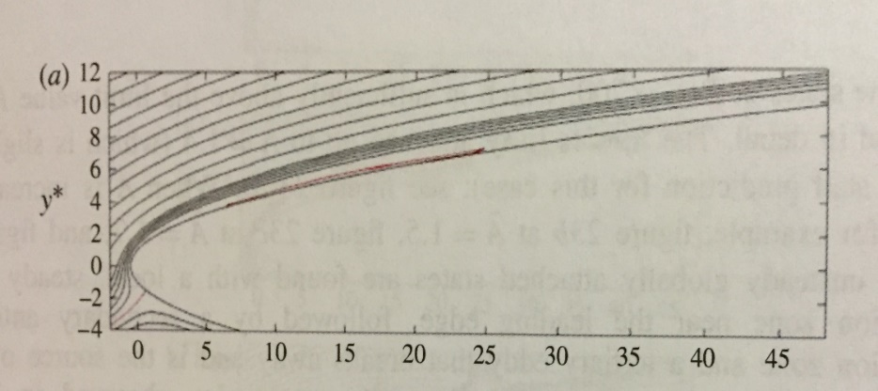
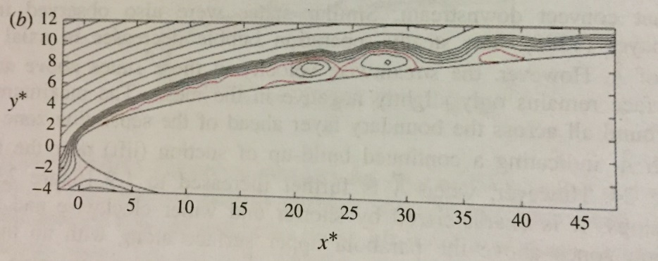
Benefits of research:
Reduced air drag over aircraft body
  Two forces in x-direction in flight:
  thrust and drag
  If drag is reduced you need less
  thrust
    Reduces the amount of fuel needed (monetary return)
Increases operational envelope
  Aircrafts could operate at higher pitch angles and slower speeds without stalling
Angle of attack = 0
Angle of attack = 6.5

Slide 8
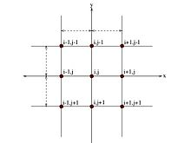
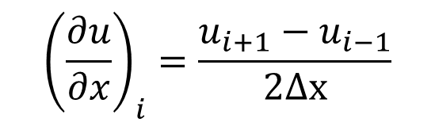
The current CFD solver
Forward time, central difference
Uses central difference scheme
  Known to be stable
Uses the left and right points
Uses every point in domain
$${\left(\frac{∂u}{∂x}\right)}_{i}=\frac{u_{i+1}−u_{i−1}}{2⁢Δx}$$

Slide 9
The current CFD solver
Forward time, central difference
Uses central difference scheme
  Known to be stable
Uses the left and right points
Uses every point in domain
$${\left(\frac{∂u}{∂x}\right)}_{i}=\frac{u_{i+1}−u_{i−1}}{2⁢Δx}$$

Slide 10
The problem: Is the current finite difference scheme the optimal choice?
Not been tested for accuracy in predicting flow fields
Current is being used because it worked
Other methods could be:
  More accurate
  Faster to compute
  More stable

Slide 11

Test scheme one: The forward difference scheme
Approximates using middle and right (front) point
Eliminates right end of domain
$${\left(\frac{∂u}{∂x}\right)}_{i}=\frac{u_{i+1}−u_{i}}{Δx}$$

Slide 12
Test scheme one: The forward difference scheme
Approximates using middle and right (front) point
Eliminates right end of domain
$${\left(\frac{∂u}{∂x}\right)}_{i}=\frac{u_{i+1}−u_{i}}{Δx}$$

Slide 13
Test scheme two: The backward difference scheme
Approximates using middle and Left (back) point
Eliminates right end of domain

Slide 14
Test scheme two: The backward difference scheme
Approximates using middle and Left (back) point
Eliminates right end of domain

Slide 15
Testing Criteria
Is the solution more accurate then central difference?
Does the solution converge faster?
Is it stable?
  Will it work for a larger variety of conditions?

Slide 16
Results – The forward difference scheme
Appears to be unconditionally unstable
  Numbers within domain diverge
  Causes program to fail
All output files have been empty

Slide 17
Results – The backwards difference scheme
Successfully produces solutions and output files
Has smaller residuals then original version
  LHS-RHS=0
  Indication of accuracy

Slide 18
Concerns - The backwards difference scheme
Residuals fall alarmingly fast within first few iterations
  Original fell from order 10¹ to 10⁻⁶
  Backwards difference fell from order 10¹ to 10⁻⁹
    Can be indication of inaccuracy
Values for the vorticity are alarmingly low
  Original had a scale that commonly went from zero to 4
  Backward scheme had a scale that went from zero to E-6

Slide 19
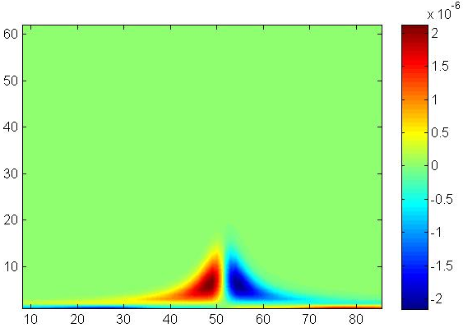
Concerns - The backwards difference scheme
Plots of simulated fluid flow are distorted
Plots of the vorticity fields shown below:
Original central difference scheme
Modified Backwards difference scheme

Slide 20
Concerns - The backwards difference scheme
Distortion could be caused by technicality of using new scheme
  Both the original and new schemes use two special steps
  At left end of the domain there are no points to its left
    Therefore the program cannot accurately approximate here
    This error could propagate

Slide 21
Implications
The forwards difference scheme appears to be useless
  However, resolving the double spacing issue could fix it
Backwards difference scheme is promising
  It has been shown to have benefits
    Faster calculations
    Possible more accurate
  Spacing issue still needs to be resolved

Slide 22
Further research
Work needs to be done on fixing the spacing issue
More data needs to be collected to validate results
  Compared with same lab geometry in many trials
  Compared with different geometry
    Geometry for which a true analytical solution exists

